Slide 1

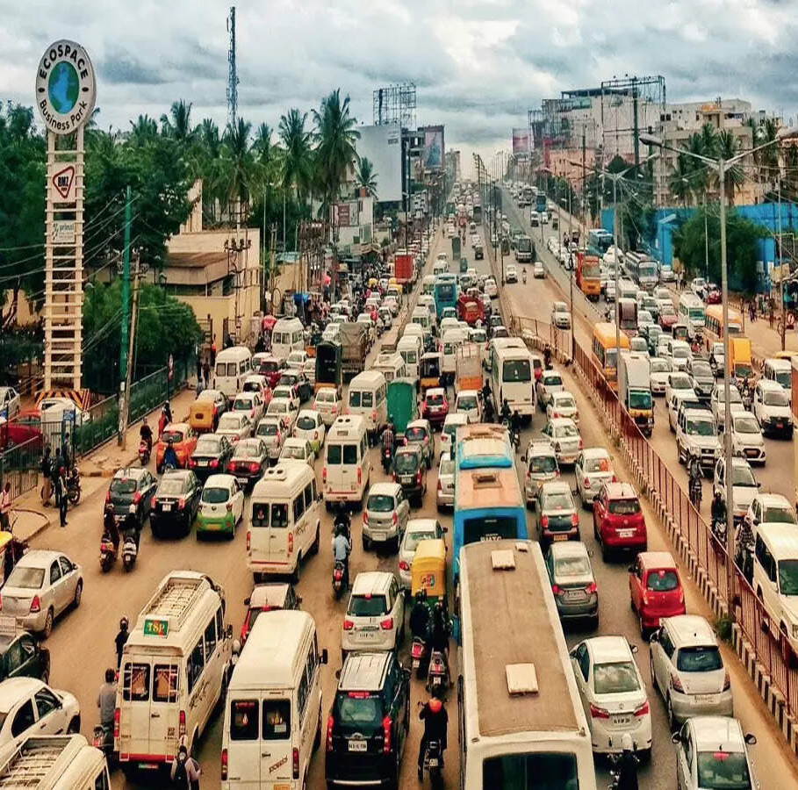
Ondu Nimisha AI
"What is the purpose of existence?
Is it to just stay in traffic?"

Slide 2
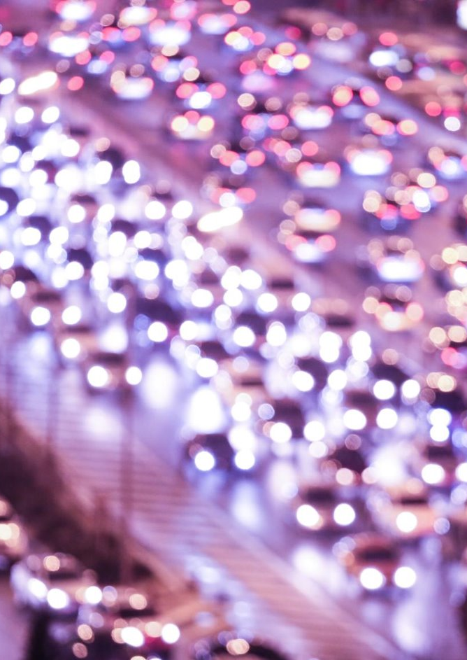
How Human Approval Distorts Traffic Flow?
The Scaling Failure: Human processing capacity is static (O(1) scaling), whereas traffic congestion and camera alerts scale exponentially (O(N)) during rush hours. This causes queue backlogs to swell precisely when rapid enforcement is needed most.
The Lost "Golden Hour" of Clearing: If a vehicle is double-parked or broken down on a major arterial artery (like Outer Ring Road), every minute it sits there causes an upstream traffic wave that takes hours to dissipate. If the human triage delay is 2.5 hours, the roadblock remains unaddressed during the entire peak window, turning a localized incident into a systemic city-wide gridlock.
Delayed Deterrent Feedback: Behavioural science proves that deterrence works best when the feedback loop is immediate. When an offender receives an automated notification within 60 seconds (“RISE AI"), they move their vehicle or change behaviour. If the ticket takes days to process, the illegal parking behaviour continues unchecked for the rest of the week.

Slide 3
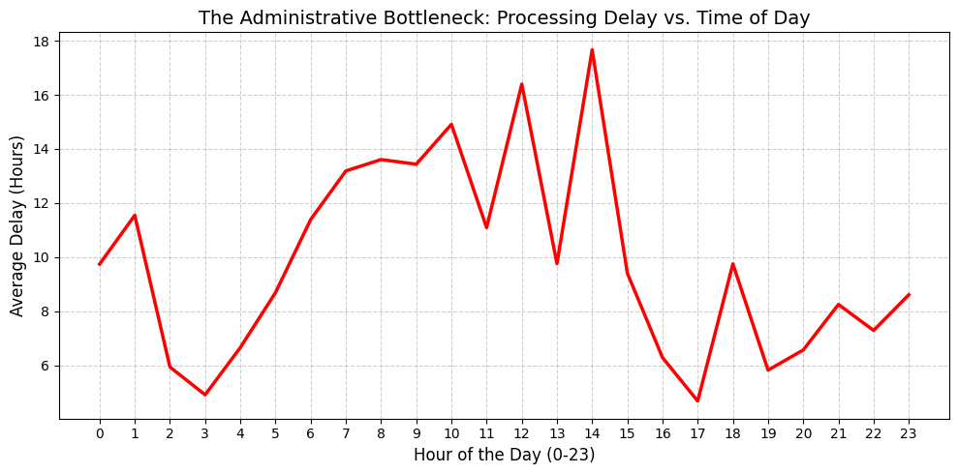
Human Capacity Bottleneck

Slide 4
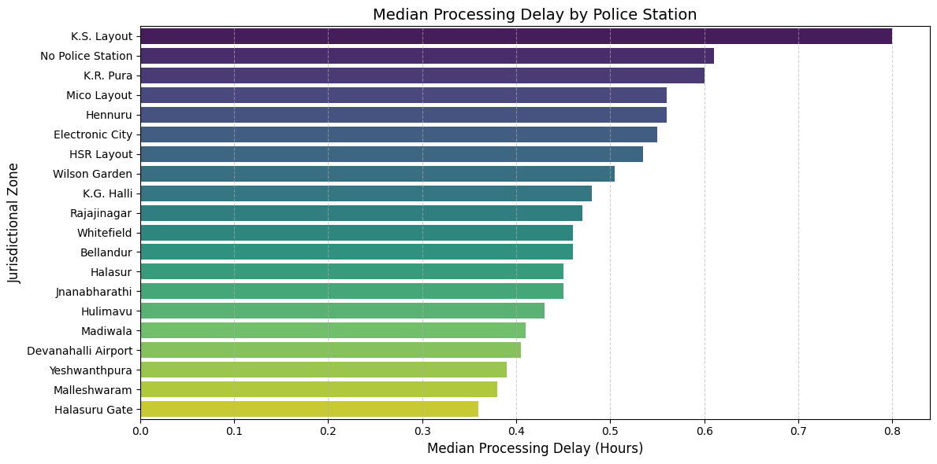
Spatial Backlog Heatmap by Jurisdictional Zone (Horizontal Bar Chart)

Slide 5
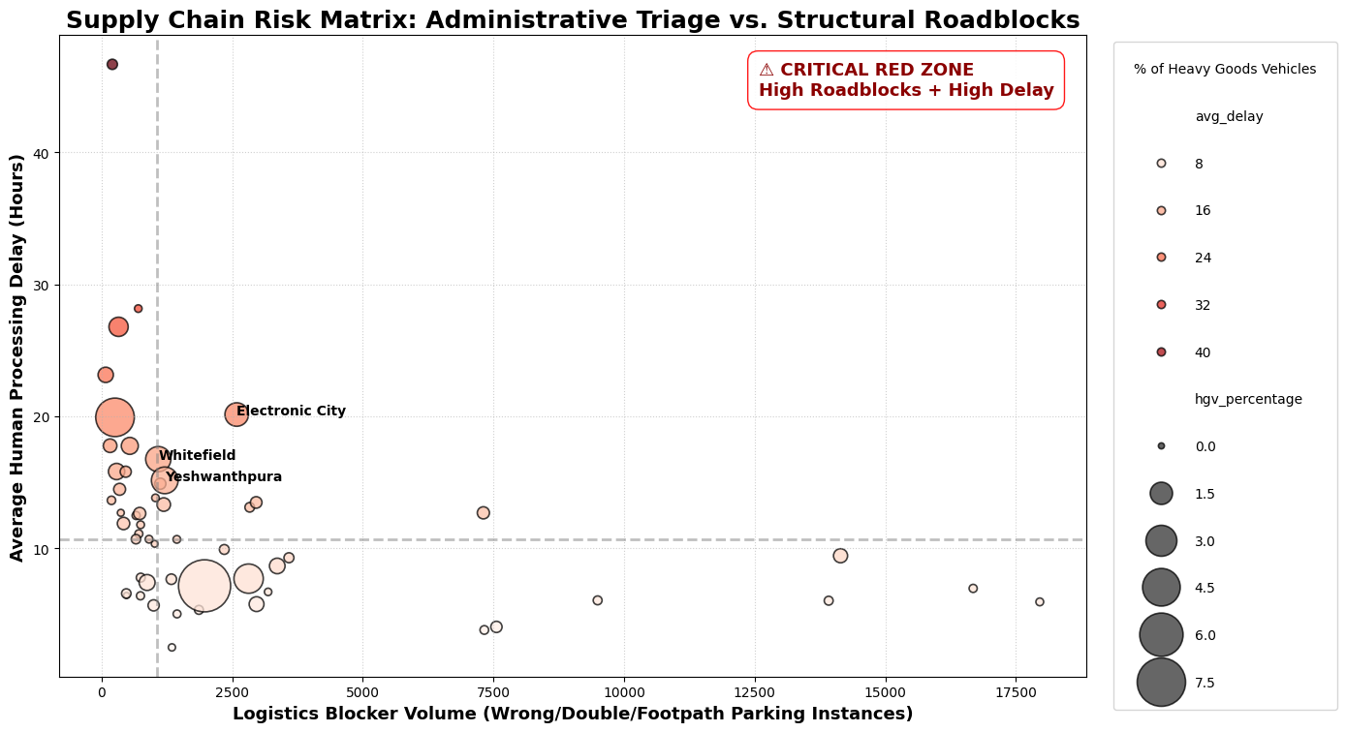
Supply Chain Risk Matrix

Slide 6
RISE AI Architecture
Police Command Center
Uses a CatBoost ML model to instantly triage camera-flagged violations, enabling rapid response in critical zones.
Logistics Intelligence Engine
Applies predictive analytics and spatial clustering to transform congestion and blockages into real-time risk matrices.
Integrated Dual-Engine Architecture
Modular, scalable design converts reactive data into proactive intelligence benefiting both municipal and commercial domains.

Slide 7
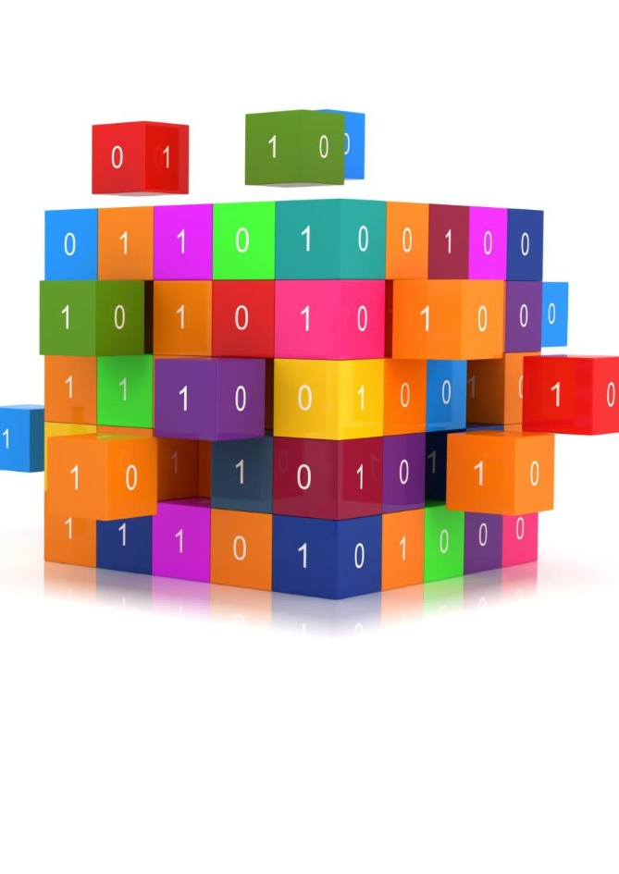
Data Cleaning and Preprocessing
One-hot encoding of Violation : One hot encoding of ‘violation_type’ column has been done so as to classify each incident with the kind of Violation done.
Dropped Columns : 'closed_datetime', 'description', 'action_taken_timestamp','id','created_by_id','device_id','closed_datetime','offence_code','action_taken_timestamp’ columns have been dropped as many of them are “NULL” and others just increase redundancy.
Temporal Feature Engineering (Cyclical Encoding): We have transformed the created, modified and validated datetime columns into cyclical(sin,cos) columns
Filling Unknown Cells : The null cells in vehicle no and vehicle type are updated as “Unknown” creating an entirely separate identity of such incidences. The null cells in datetime are assigned as “-2”as it is out of range for (sin,cos) transforms signifying separate category.

Slide 8
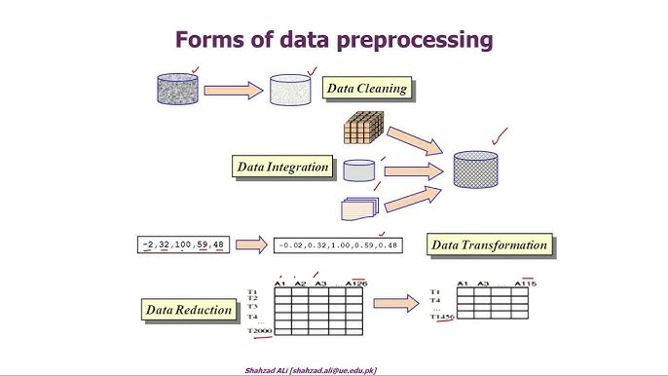
Data Cleaning and Preprocessing
Binary Weekend Flag: A is_weekend flag is created based on the day_of_week (1 for Saturday/Sunday, 0 otherwise). It done so that model should learn how traffic violation spikes during weekends due to holidays
Target Variable Normalization: The raw validation_status column is transformed into a strict binary target variable: status_APPROVED (1 for "APPROVED", 0 for everything else).
Spatial Engineering (DBSCAN & KDTree/BallTree): We have converted raw Latitude/Longitude values into radians. Applied the Haversine metric to account for the Earth's curvature. We used DBSCAN to group dense geographic coordinates into specific clusters (e.g., Cluster_3) based on a 200-meter radius. Compiled these clusters into a BallTree matrix for rapid spatial lookups during inference.

Slide 9
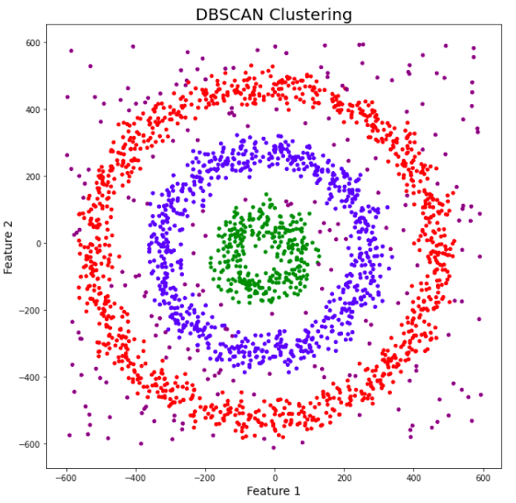
Training and Impelementing a CatBoostModel
DB Scan : DB scan is used to form clusters using the latitudes and longitude points given from the datasets. It is easier to compute clustered in the CatBoost model for learning instead of the longitude and latitude numbers. However, this model of clustering is super slow, which can hamper the under one minute computation of our prototype. Therefore to solve this issue, BallTree is used.
BallTree : BallTree is used to store the mapped points and the cluster ids because doing DB scan every single time on the whole map for a single new point is computationally expensive.

Slide 10
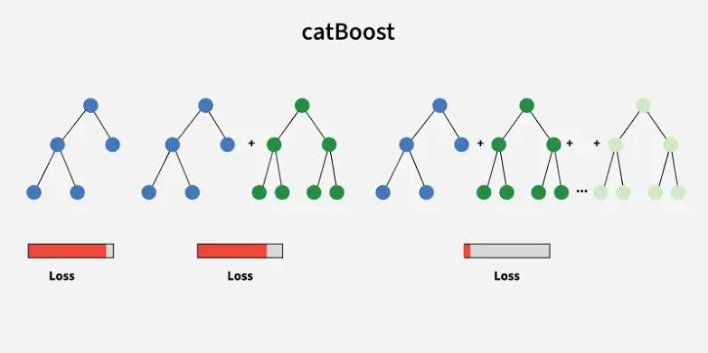
Training and Impelementing a CatBoostModel
Categorical cols : 'police_station', 'junction_name', 'vehicle_type', 'cluster_id’ are given as categorical columns for precise classification by the CatBoost model.
y = df['validation_status'].apply(lambda x: 1 if str(x).upper() == 'APPROVED' else 0): This is the target variable normalization done to give a precise and clear output for any traffic violation complaint received.

Slide 11
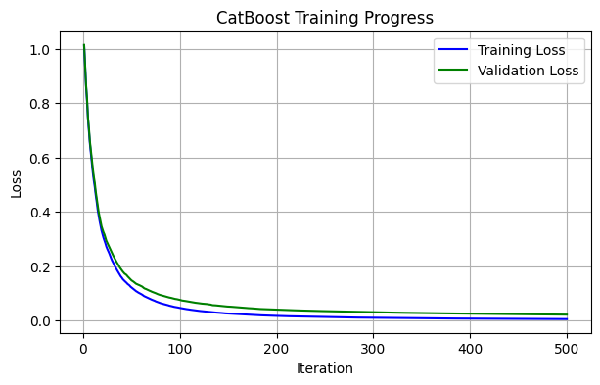
Training and Impelementing a CatBoostModel
“leaky_columns = ['validation_status', 'data_sent_to_scita', 'data_sent_to_scita_timestamp’, 'updated_vehicle_number', 'updated_vehicle_type', 'is_validated','val_is_weekend', 'val_time_sin', 'val_time_cos', 'val_day_sin', 'val_day_cos', 'val_month_sin', 'val_month_cos’]
useless_text_columns = ['id', 'location', 'vehicle_number’]
X = df.drop(columns=leaky_columns + useless_text_columns, errors='ignore’)”
The validation columns are dropped preventing Data Leakage by Omitting Target Outputs and vehicle number is dropped to prevent model from memorizing the violation according to specific vehicles.
Dropping all these columns is an effort to make this model more generalized and more centred towards locality, vehicle type and month, date, time .

Slide 12
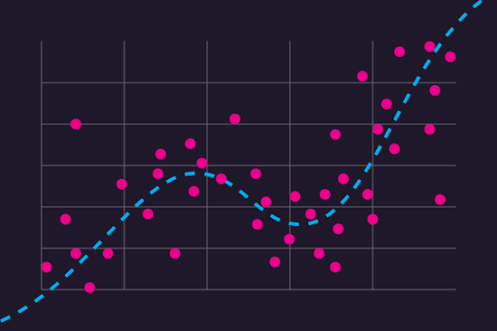
Training and Impelementing a CatBoostModel
cb_model = CatBoostClassifier(cat_features = categorical_cols, iterations=500,depth=6, learning_rate=0.1, verbose=50)
CatBoost Model is used so that it does not require one-hot encoding of category columns instead it handles categorical strings natively using Ordered Target Statistics. This feature is important because already our data has pretty large number of columns and rows, One-hot encoding increases data unnecessarily inturn increasing processing time.
The depth is kept at 6 so that the model only learns the general features of the dataset. Increasing the depth, the model starts memorizing specific traffic violations incidents.
Iterations and learning rate are kept such that the model takes minimal time and space so as to compute the validation of any complaint uploaded to it.
By capping the trees at 500, we guarantee the compiled model size is tiny (under 5MB) and the prediction happens in under 10 milliseconds.

Slide 13
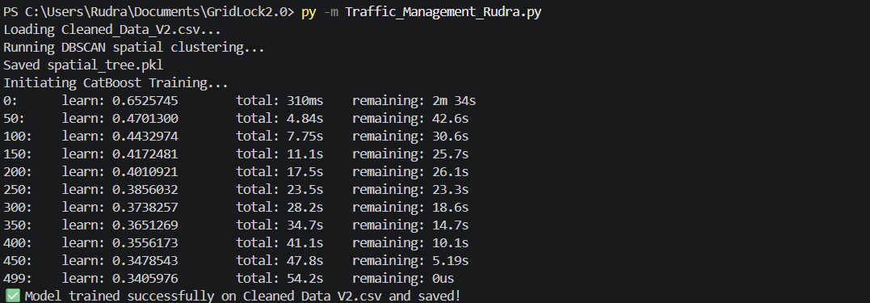
Output of CatBoost Model

Slide 14
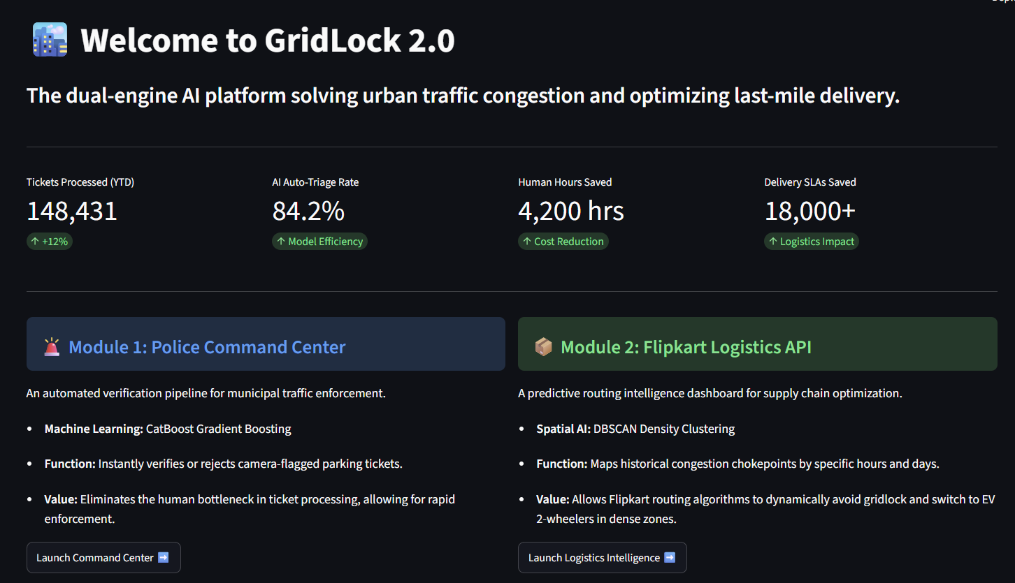
Overview of the Application Prototype
Model Initialization (@st.cache_resource): The compiled CatBoost model is loaded (traffic_management_model_Rudra.cbm) into a cached resource. This ensures the heavy model weights are loaded into the server's RAM only once upon startup, completely eliminating latency when a dispatcher requests a new prediction.
Dynamic Data Hydration (@st.cache_data): Rather than hardcoding dropdown menus, the app dynamically reads the unique police_station and junction_name values directly from the cleaned dataset. This makes the application scalable; if new jurisdictions are added to the CSV, the UI updates automatically without requiring code changes.
Reverse Trigonometry: For the logistics dashboard, you engineered a function that takes the mathematically transformed cyclical variables (time_sin, time_cos) and applies reverse trigonometry (np.arctan2) to translate them back into human-readable hours, days, and months.

Slide 15
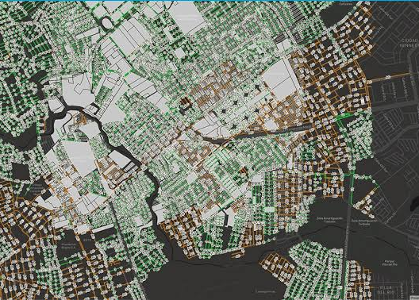
Overview of the Application Prototype
To bridge the gap between human input and mathematical coordinates, you integrated an external geocoding service.
ArcGIS Integration: You utilized the geopy library to tap into the ArcGIS API. When a traffic officer enters a text-based address (e.g., "18th Main Road, Koramangala"), the system sends a cascading series of queries to the API, falling back to broader queries if the exact street is not found.
State Management: The resulting latitude and longitude coordinates are injected into Streamlit's st.session_state. This ensures the coordinates persist across the application, allowing the user to seamlessly transition from geocoding to the ML execution pipeline without losing their location data.

Slide 16
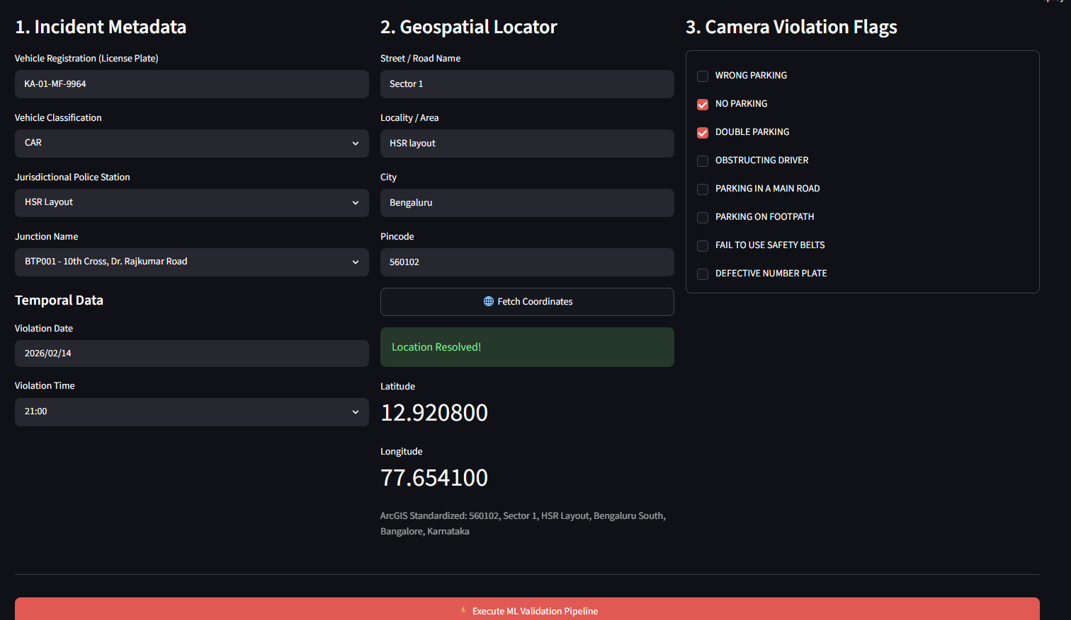
🚨 Engine 1: Police Command Center
Data Aggregation: The UI captures three streams of data: Incident Metadata (vehicle info, time), Geospatial Location (from the ArcGIS layer), and specific Violation Flags (via checkboxes).
The Spatial Relay Race: Before making a prediction, the app loads your serialized spatial_tree.pkl (the BallTree index). It takes the newly fetched GPS coordinates, converts them to radians, and executes a sub-millisecond nearest-neighbor lookup (spatial_tree.query). If the new incident is within 200 meters of a historical chokepoint, it dynamically assigns that ticket to the specific Cluster_ID.
Feature Alignment & Inference: The app constructs an inference dataframe mimicking the exact state of the data during training. It applies Sine/Cosine transformations to the inputted time and converts the boolean checkboxes into integer flags (1s and 0s). Crucially, you utilized the cb_model.feature_names_ attribute to forcefully align the input columns and pad any missing features with "UNKNOWN" or "0.0", effectively bulletproofing the app against data-type crashes.
Output Rendering: The model outputs a probability score using .predict_proba(). If the confidence exceeds 40%, the system approves the ticket. A dynamic Folium map is then generated, plotting a 200-meter radius around the incident and overlaying the historical cluster data points to visually justify the AI's spatial logic to the human operator.

Slide 17
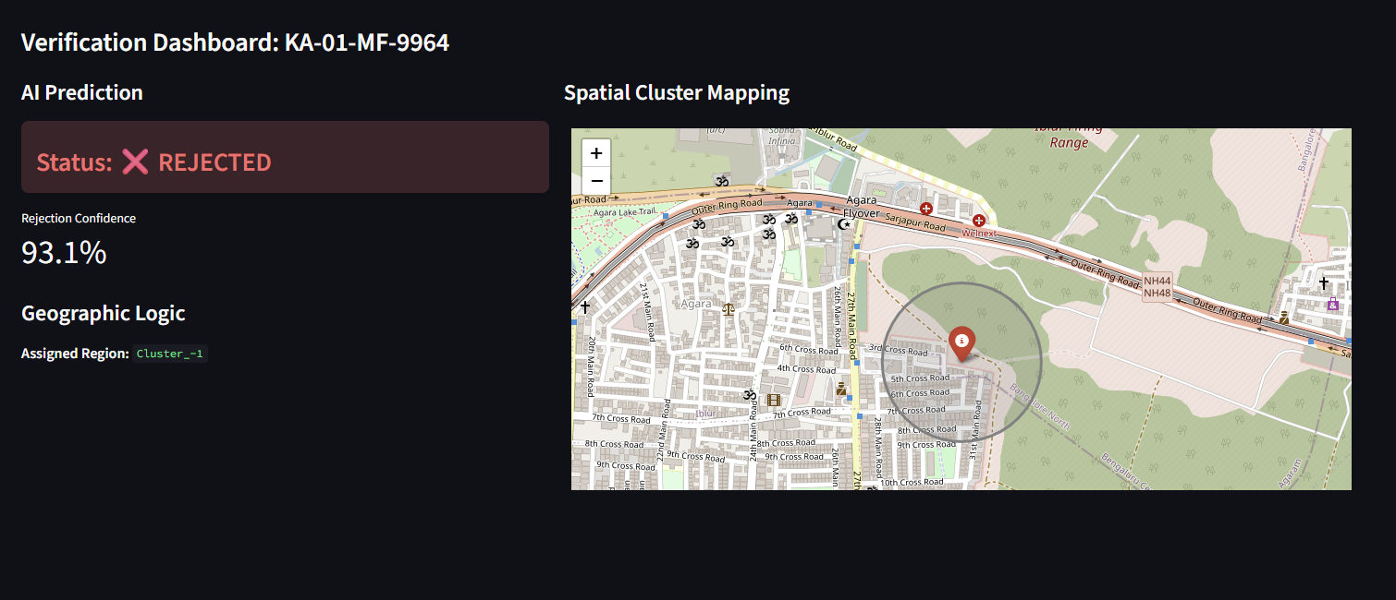
Automated Complaint Decision

Slide 18
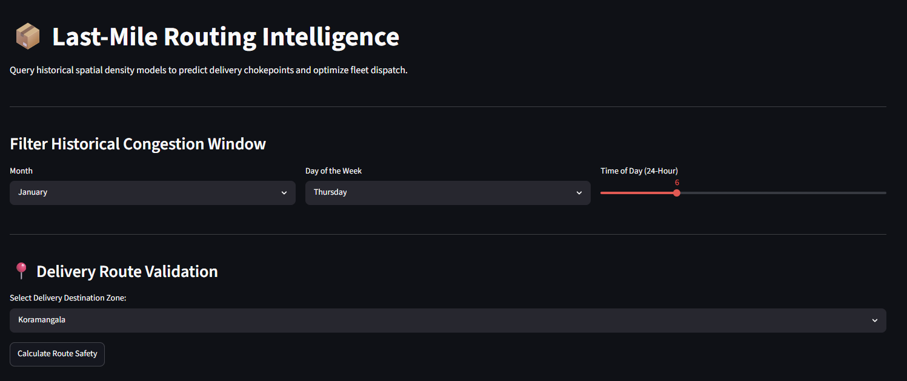
📦Engine 2: Predictive Logistics (Flipkart API)
Temporal Filtering: Users manipulate sliders and dropdowns to select a specific operational window (e.g., Friday at 18:00). The app cross-references this against the reverse-engineered logistics dataframe to isolate historical congestion patterns for that exact time slice.
Threshold Triage: You implemented a routing logic script that evaluates the volume of active violations in a target delivery zone. If the volume breaches a set threshold (e.g., 50 violations), the system triggers a "High Congestion Alert."
Dynamic Fleet Protocol: Based on the severity of the spatial bottlenecks, the app automatically recommends a shift in logistics strategy—advising a switch from Heavy Goods Vehicles to Light Vans, or pivoting to 2-Wheeler EVs in severe gridlock.
The Dark Matter Map: To visualize the operational impact, the dashboard renders a specialized CartoDB dark_matter Folium map. It samples the active chokepoints and scales the marker radii based on the vehicle type involved, visually highlighting exactly where heavy trucks are currently paralyzed across Bengaluru.

Slide 19
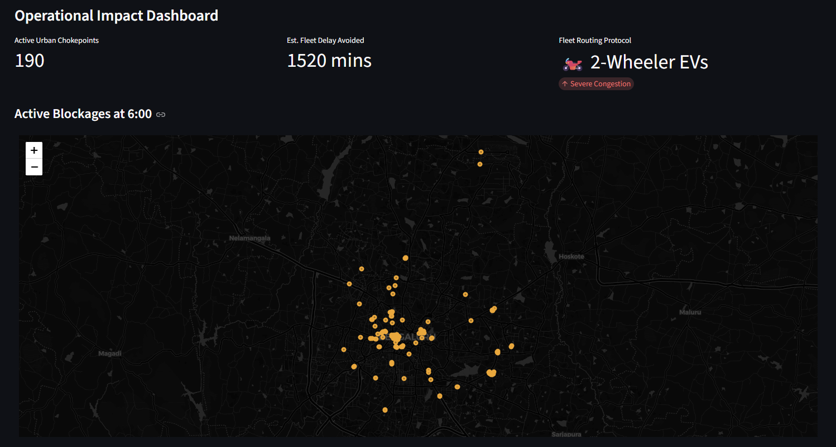
Data-Driven Route Insights

